Slide 2
Management Information Systems (MIS)
Dr. Mwai

Slide 3
Week 1: Introduction to MIS - Learning Objectives
By the end of this week, students should be able to:
• Define MIS and explain its importance.
• Describe the role of MIS in organizations.
• Identify components of MIS: people, technology, processes.

Slide 4
Definition and Importance of MIS
MIS: A system combining people, technology, and processes to provide information for decision-making.
Importance:
Enhances decision-making.
Improves efficiency and productivity.
Supports planning, controlling, and organizing.
Provides competitive advantage.

Slide 5
Information Systems in Global organizations/ Business Today
The Role of Information Systems in organizations/ Business Today
Information technology and systems have revolutionized firms and industries, becoming the largest component of capital investment in most countries and many industrialized societies. Investment in information technology accounts for approximately 50 percent of all capital invested.
Information technology capital investment, defined as hardware, software, and communications equipment, grew from 34% to 50% between 1980 and 2004. Source: Based on data in U.S. Department of Commerce, Bureau of Economic Analysis, National Income and Product Accounts, 2006.

Slide 6
Discussion points
Why this change and why are organizations increasingly investing more and more in information systems ?
What are some of the factors that are leading organizations to invest in information systems?
What are some of the results(advantages ) of this investment in formation systems to organizations?

Slide 7
The Role of Information Systems in Organizations/Business Today…
Information systems are transforming business and the visible results of this include the increased use of cell phones and wireless telecommunications devices, a massive shift toward online news and information, booming e-commerce and Internet advertising,
The Internet has also drastically reduced the costs of businesses operating on a global scale.

Slide 8
These changes have led to the emergence of the digital firm, a firm in which:
Most of the firm's significant business relationships with customers, suppliers, and employees are digitally enabled and mediated.
Core business processes, or logically related business tasks, are accomplished through digital networks.
Key corporate assets (intellectual property, core competencies, and financial and human assets) are managed through digital means
Business responses to changes in their environment are enhanced through digital communications, allowing for time shifting (business being conducted 24x7) and space shifting (business being conducted globally or beyond traditional geographic boundaries).
The ability of a firm to use IT is becoming intertwined with the firm's ability to implement corporate strategy. Figure 1-2 below

Slide 9
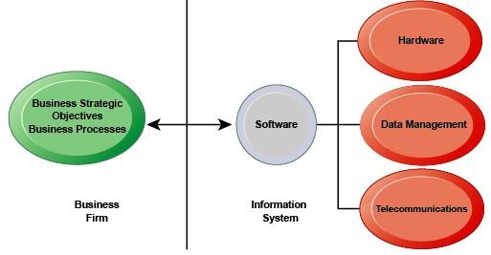
FIGURE 1-2 THE INTERDEPENDENCE BETWEEN ORGANIZATIONS AND INFORMATION SYSTEMS

Slide 10
Organizations/Business firms invest heavily in information systems to achieve six strategic business objectives:
Operational excellence: Efficiency, productivity, and improved changes in business practices and management behavior
New products, services, and business models: A business model describes how a company produces, delivers, and sells a product or service to create wealth. Information systems and technologies create opportunities for products, services, and new ways to engage in business.
Customer and supplier intimacy: Improved communication with and service to customers raises revenues, and improved communication with suppliers lowers costs.
Improved decision making: Without accurate and timely information, business managers must make decisions based on forecasts, best guesses, and luck, a process that results in over and under-production of goods, raising costs, and the loss of customers.
Competitive advantage: Implementing effective and efficient information systems can allow a company to charge less for superior products, adding up to higher sales and profits than their competitors.
Survival: Information systems can also be a necessity of doing business. A necessity may be driven by industry-level changes, as in the implementation of ATMs in the retail banking industry. A necessity may also be driven by governmental regulations, such as National or County statutes requiring a business to retain data and report specific information.

Slide 11
Perspectives on Information Systems
An information system is a set of interrelated components that collect or retrieve, process, store, and distribute information to support decision making and control in an organization.
Information systems can also be used to analyze problems, visualize complex subjects, and create new products.
Information is data, or raw facts, shaped into useful form for humans. Figure 1-3

Slide 12
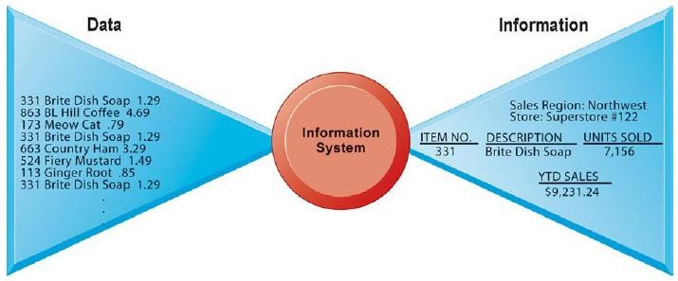
FIGURE 1-3 DATA AND INFORMATION

Slide 13
Raw data from a supermarket checkout counter can be processed and organized to produce meaningful information, such as the total unit sales of dish detergent or the total sales revenue from dish detergent for a specific store or sales territory.
Input, processing, and output are the three activities in an information system that produce the information an organization needs.
Input captures or collects raw data from within the organization or from its external environment.
Processing converts this raw input into a meaningful form.
Output transfers the processed information to the people who will use it or to the activities for which it will be used.
Information systems also require feedback, which is output that is returned to appropriate members of the organization to help them evaluate or correct the input stage.

Slide 14
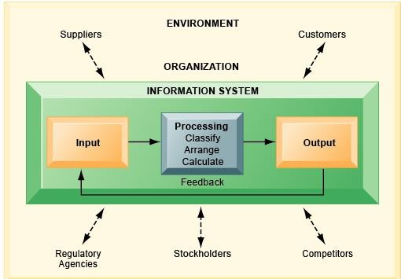
FIGURE 1-4 FUNCTIONS OF AN INFORMATION SYSTEM

Slide 15
An information system contains information about an organization and its surrounding environment. Three basic activities—input, processing, and output—produce the information organizations need.
Feedback is output returned to appropriate people or activities in the organization to evaluate and refine the input.
Environmental actors, such as customers, suppliers, competitors, stockholders, and regulatory agencies, interact with the organization and its information systems.
It is important to distinguish information systems, which are designed to produce information and solve organizational problems, from the computer technology and software that is typically used to create and manage information systems.
Computer literacy focuses primarily on knowledge of information technology.
Information systems literacy, the understanding of information systems, includes a behavioral and technical approach to understanding the broader organization, management, and information technology dimension of systems and their power to provide solutions.
The field of management information systems (MIS) tries to achieve this broader information systems literacy. Figure 1-5 below

Slide 16
Role of MIS in Organizations
Operational: Automates routine tasks (payroll, inventory).
Managerial: Summarizes reports for middle management.
Strategic: Supports long-term planning.
Communication: Enhances information flow.
Decision Support: Reduces uncertainty.
Case: Banks using MIS for transaction monitoring.

Slide 17
Components of MIS
• People – Managers, staff, IT specialists.
• Technology – Hardware, software, networks.
• Processes – Workflows, policies, procedures.
All three must align for effective MIS.

Slide 18
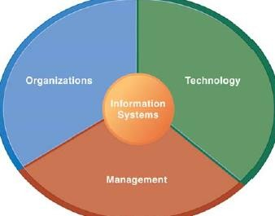
Using information systems effectively requires an understanding of the organization, management, and information technology shaping the systems. An information system creates value for the organization as an organizational and management solution to challenges posed by the environment. The dimensions of information systems include organizations, management, and information technology.

Slide 19
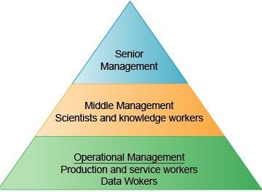
The key elements of an organization are its people, structure, business processes, politics, and culture.
An organization coordinates work through a structured hierarchy and formal standard operating procedures. Managerial, professional, and technical employees form the upper levels of the organization's hierarchy while lower levels consist of operational personnel.
Figure 1-6

Slide 20
LEVELS IN A FIRM
Business organizations are hierarchies consisting of three principal levels: senior management, middle management, and operational management. Information systems serve each of these levels.
Scientists and knowledge workers often work with middle management.
Senior management makes long-range strategic decisions and ensures the firm's financial performance.
Middle management carries out the plans of senior management and operational management monitors the firm's daily activities. Knowledge workers such as engineers and scientists design products and create and distribute new knowledge for the organization.
Data workers such as secretaries process the organization's paperwork.
Production or service workers produce the products or services.
Experts are employed for the major business functions: the specialized tasks performed by organizations, which consist of sales and marketing, manufacturing and production, finance and accounting, and human resources.

Slide 21
Each organization has a unique culture, or fundamental set of assumptions, values, and ways of doing things, that are accepted by most of its members.
Parts of an organization's culture can be found in its information systems. For example, UPS's organizational focus on customer service can be found in the package tracking system available to customers.
Information systems may also reflect the organizational politics or conflicts that result from differing views and opinions in an organization. Information systems are also a key component in the ability of management to make sense of the challenges facing a company and in management's ability to create new products and services, manage the company, and even re-create the organization from time to time. Information technology is one of the many tools used by management to cope with change.
A firm's information technology (IT) infrastructure is a technology platform or foundation on which a firm can build its information systems. IT infrastructure consists of:

Slide 22
Computer hardware: The physical equipment and computing devices used for input, storage, processing, output, and telecommunications
Computer software: The detailed, preprogrammed instructions that control and coordinate the computer hardware components
Data management software: The software governing the organization of data on physical storage media
Networking and telecommunications technology: Hardware and software used to link the various pieces of hardware and transfer data from one physical location to another; a computer network links two or more computers together to share data, such as files, images, sounds, video, or share resources, such as a printer.
The Internet is the world's largest and most widely used network. The Internet is a global network that uses universal technology standards to connect many private and public networks. The universal standards and technologies used in the Internet are also used in systems and networks within the firm.
Intranets are internal corporate networks based on Internet technology, and extranets are corporate networks extended to authorized users outside of the firm.
The World Wide Web is a service provided by the Internet that uses universally accepted standards for storing, retrieving, formatting, and displaying information in a page format on the Internet. Web pages contain text, graphics, animations, sound, and video and are linked to other Web pages. The Web can serve as the foundation for new kinds of information systems such as UPS's Web-based package tracking system

Slide 23
From a business perspective, an information system is an important instrument for creating value for the firm.
Information systems enable the firm to increase its revenue or decrease its costs by providing information that helps managers make better decisions or that improves the execution of business processes.
Every business has an information value chain in which raw data is systematically acquired and then transformed through various stages that add value to that information.
The value of an information system to a business, as well as the decision to invest in any new information system, is, in large part, determined by the extent to which the system will lead to better management decisions, more efficient business processes, and higher firm profitability

Slide 24
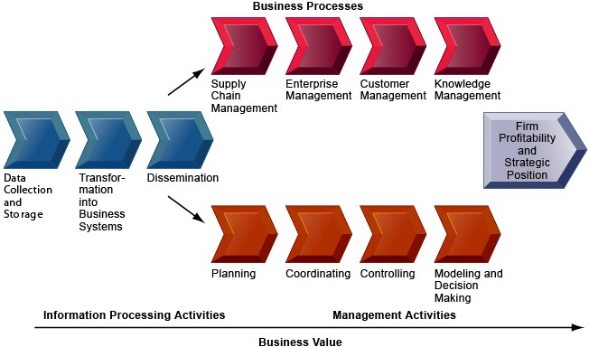
THE BUSINESS INFORMATION VALUE CHAIN

Slide 25
From a business perspective, information systems are part of a series of value-adding activities for acquiring, transforming, and distributing information that managers can use to improve decision making, enhance organizational performance, and ultimately increase firm profitability.
The business perspective calls attention to the organizational and managerial nature of information systems. An information system represents an organizational and management solution based on information technology to a challenge or problem posed by the environment.
Some firms achieve better results from their information systems than others. Studies of returns from information technology investments show that there is considerable variation in the returns firms receive. Reasons for lower return on investment include failure to adopt the right business model that suits the new technology or seeking to preserve an old business model that is doomed by new technology.

Slide 26
Although, on average, investments in information technology produce returns far above those returned by other investments, there is considerable variation across firms.
Information technology investments cannot make organizations and managers more effective unless they are accompanied by complementary assets: assets required to derive value from a primary investment. For instance, to realize value from automobiles requires complementary investments in highways, roads, gasoline stations, repair facilities, and a legal regulatory structure to set standards and control drivers.

Slide 27
Complementary investments include:
Organizational assets: These include a supportive business culture that values efficiency and effectiveness, an appropriate business model, efficient business processes, decentralization of authority, highly distributed decision rights, and a strong information system (IS) development team.
Managerial assets: These include strong senior management support for change, incentive systems that monitor and reward individual innovation, an emphasis on teamwork and collaboration, training programs, and a management culture that values flexibility and knowledge.
Social assets: These are not made by the firm but by the society at large, other firms, governments, and other key market actors, such as the Internet, educational systems, network and computing standards, regulations and laws, and the presence of technology and service firms.
Research indicates that firms that support their technology investments with investments in complementary assets, such as new business processes or training, receive superior returns. These investments in organization and management are also known as organizational and management capital.

Slide 28
Contemporary Approaches to Information Systems
Information systems are sociotechnical systems. Although they are composed of machines, devices, and "hard" physical technology, they require substantial social, organizational, and intellectual investments to make them work properly.
Since problems with information systems—and their solutions—are rarely all technical or behavioral, a multidisciplinary approach is needed.
Figure 1-9 below

Slide 29
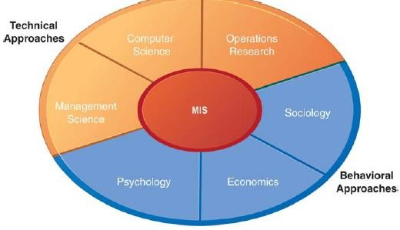
FIGURE 1-9 CONTEMPORARY APPROACHES TO INFORMATION SYSTEMS

Slide 30
The study of information systems deals with issues and insights contributed from technical and behavioral disciplines.
The technical approach emphasizes mathematically based, normative models to study information systems, as well as the physical technology and formal capabilities of these systems.
The behavioral approach, a growing part of the information systems field, does not ignore technology, but tends to focus on non-technical solutions concentrating instead on changes in attitudes, management and organizational policy, and behavior.
MIS combines the work of computer science, management science, and operations research with a practical orientation toward developing system solutions to real-world problems and managing information technology resources.
It is also concerned with behavioral issues surrounding the development, use, and impact of information systems, which are typically discussed in the fields of sociology, economics, and psychology.
In the sociotechnical view of systems, optimal organizational performance is achieved by jointly optimizing both the social and technical systems used in production. Adopting a sociotechnical systems perspective helps to avoid a purely technological approach to information systems.
Technology must be changed and designed, sometimes even "de-optimized," to fit organizational and individual needs. Organizations and individuals must also be changed through training, learning, and planned organizational change to allow technology to operate and prosper.

Slide 31
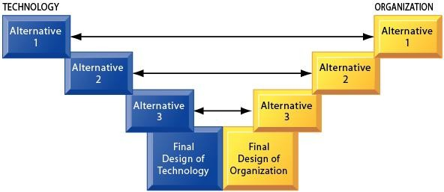
In a sociotechnical perspective, the performance of a system is optimized when both the technology and the organization mutually adjust to one another until a satisfactory fit is obtained.

Slide 32
Week 1 Activities & Questions
Activity 1: Groups identify MIS in banks, hospitals, universities.
Discussion:
1. Why is MIS vital for managers today?
2. How is MIS different from raw data systems?
3. Which MIS component is most critical?
Group Activity 2: Discuss a local company (e.g., Safaricom, Kenya Power). Analyze how MIS supports its operations. Output: 5-minute group presentation.

